Slide 1
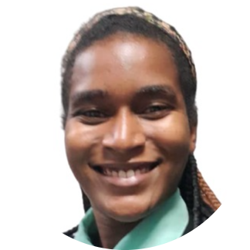
FINANCIAL INDEPENDENCE OF WOMEN
Introduction
01
02
Context
03
Analysis
Gothie Ridgina PASTEUR
Student at Ayiti Analytics
Memorante in Public Administration at INAGHEI
04
Conclusion

Slide 2
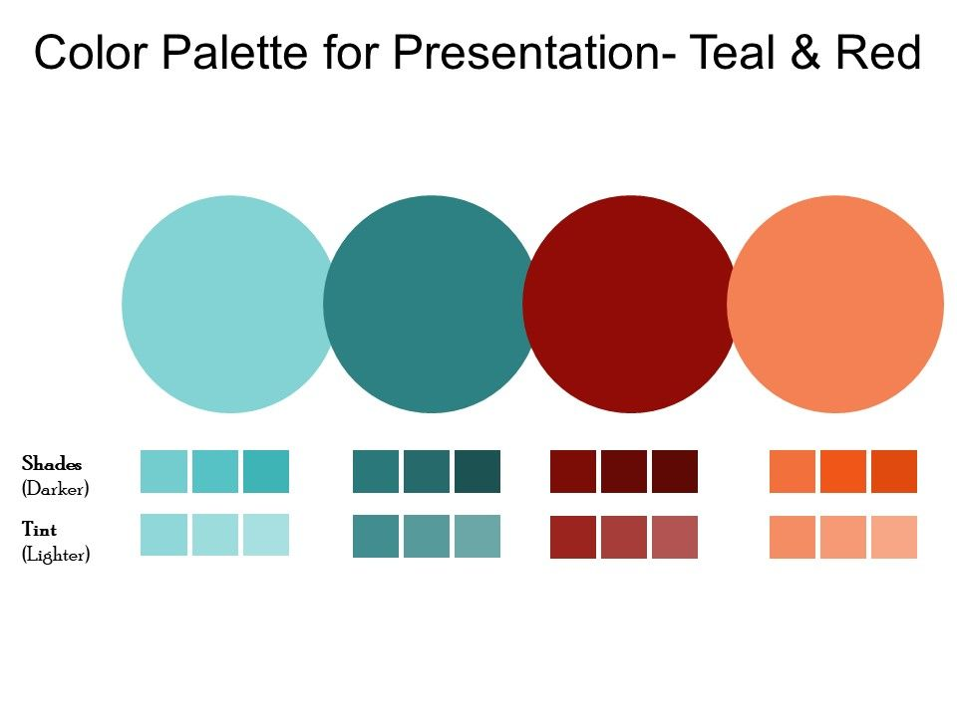
INTRODUCTION
51 %
What person can say that they don't like to make their own decisions and live their life freely? What person can say that he or she does not want to be free from need and have the courage to take care of his or her loved ones? This dream is everyone's, hence the importance of financial independence, which by definition is having enough money to maintain the desired lifestyle. This concept has not always had the same value for both sexes. On the women's side, financial independence is not only the fact of having freedom of expression or freedom of action but also a guarantee of physical and mental protection. In the 20th century, some institutions started to give in to the claim of having the right to work, to have access to financial services and to own property without a man's permission. In Haiti, despite the positive evolution of gender equality, the economic emancipation of women has not reached its peak. In this context, we thought that the profile of financially independent women should be emphasized in order to help the institutions concerned and the 51% of women in question to make better decisions

Slide 3

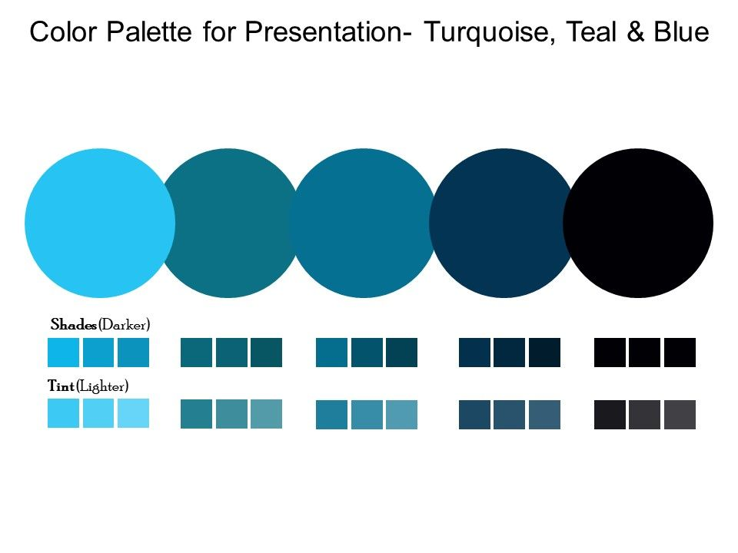
DATA ACQUISITION AND PROCESS
To do this work, we analyzed the data on the status of women from the EMMUS 2016. This project is aimed at women and men because in one way or another they have their part to play in this fight. Secondly, this project targets the institutions concerned with gender equality, respect for women's rights, economic empowerment and other issues.
The variable financial independence was the result of the score attributed to three variables including: making decisions, having a job, having an occupation, having the right to at least one financial service. Then we analyzed the main variable with the demographic variables.
We used the python language with the library pandas, numpy, skealrn seaborn

Slide 4
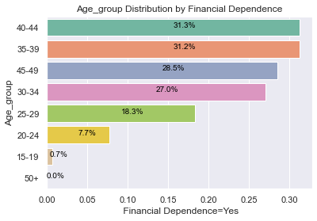
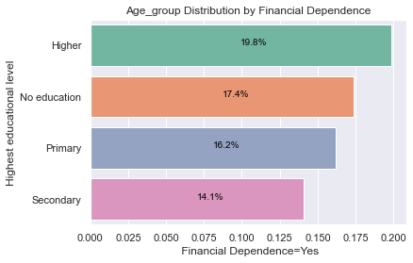
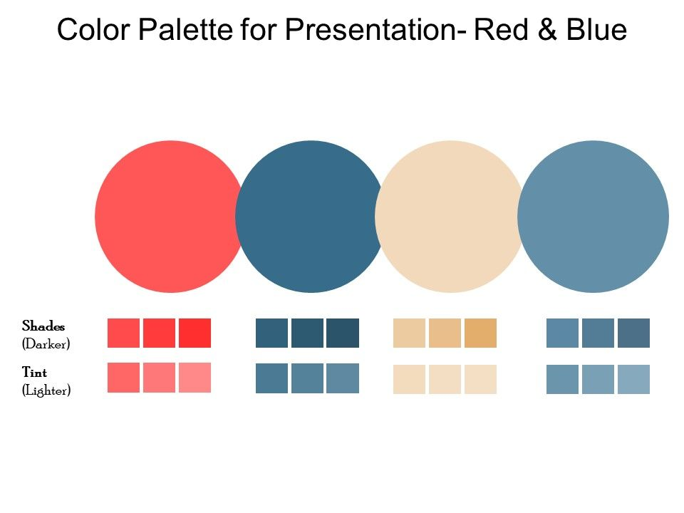
RESULT Of The ANALYSIS
By analyzing the dataset of 15513 observations, we see that only 15,71% women meet the characteristics of independence

Slide 5
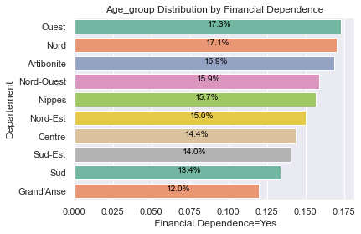
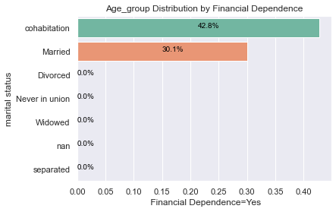
Result of the Analysis

